Slide 1
Extract Installation Planograms from a specific Store
All Installation planograms will be exported to a PDF
Compile all installation planogram PDFs to 1 PDF file

Slide 2
select * from ix_sys_printlist_data
where printlistkey in (120,126,135,138)
begin tran
update ix_sys_printlist_data
set layoutfile = 'C:\Program Files\JDA\Intactix\Space Planning\Layout\Side print template without backsheet.psy'
where printlistkey in (120,126,135,138)
commit

Slide 3
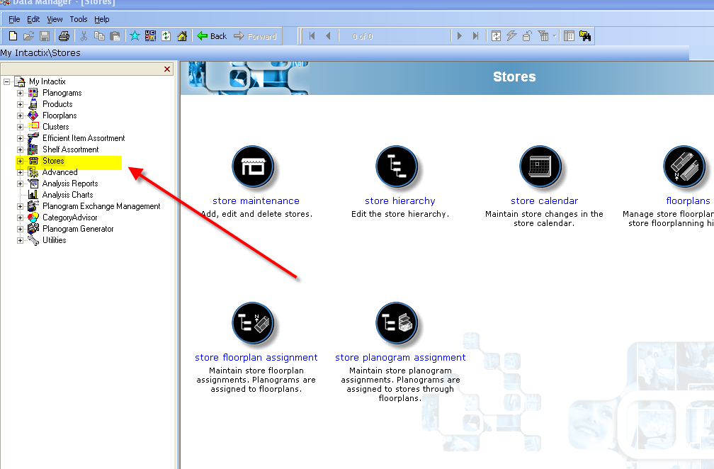

Slide 4
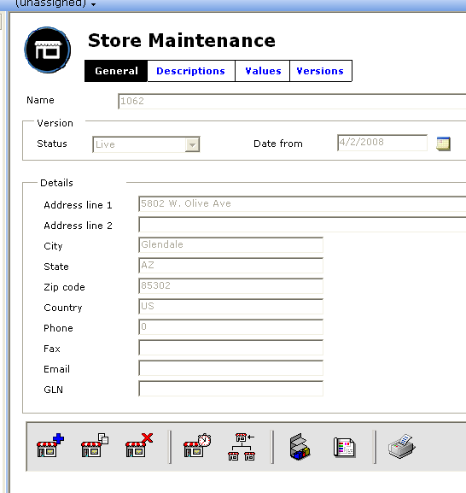
Query the Store that we need to print the installation planogram from
Click on print icon to list the installation planogram we want to print

Slide 5
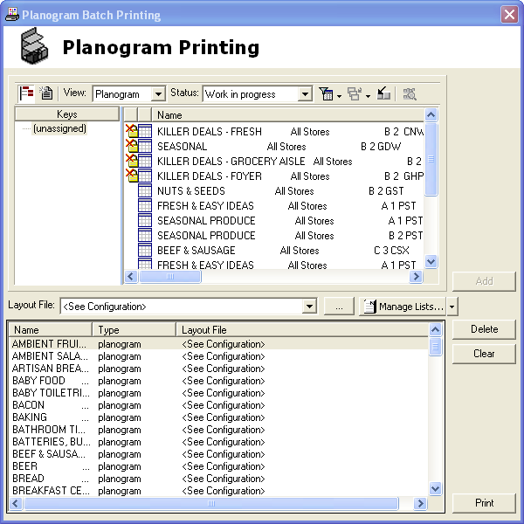
The print window will appear these are all the POGs that can be printed for the store, however the layout configuration file is not set
There’s a known issue that when you select a layout file in the drop down list it won’t use the layout file to print out.
The onlu solution is to manually modify it from the SQL database
A print list will be created
Click on Manage list button to save the current list

Slide 6

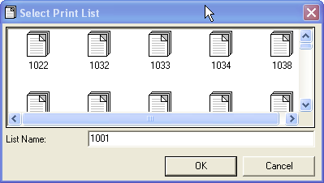
Click on Manage list button to save the current list
Select Save Print List
Enter the current store number
And click OK!
Print List for store 1001 is saved!

Slide 7
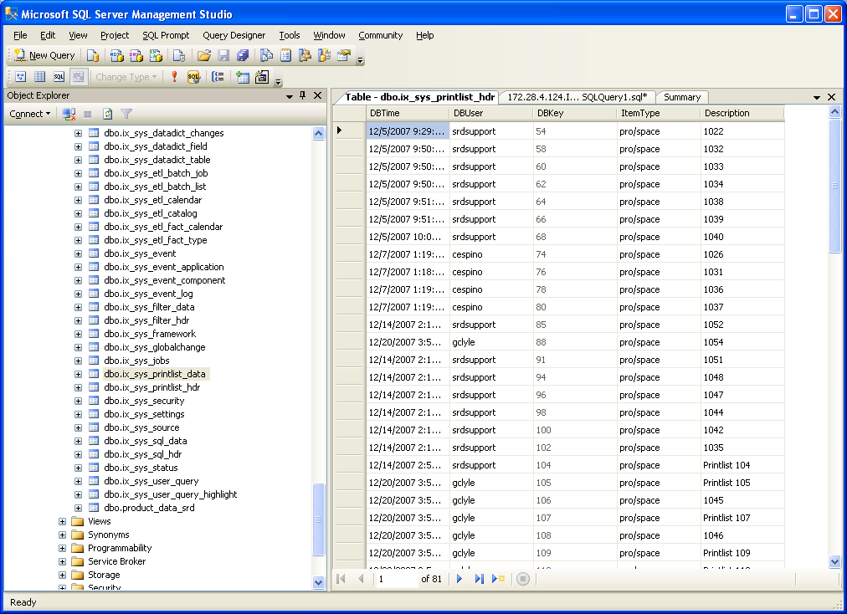
Open SQL Server Management Studio > IKB database
We will access 2 tables
Dbo.ix_sys_printlist_hdr – to identify the assigned printlist to dbkey
Dbo.ix_sys_printlist.data – to dbkey from ix_sys_printlist_hdr and change the layout file configuration

Slide 8
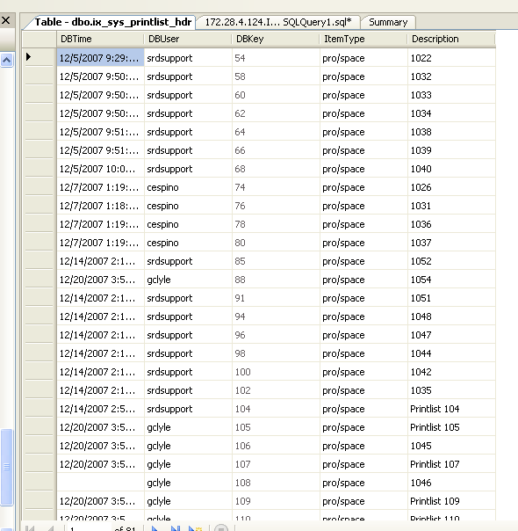
From dbo.ix_sys_printlist_hdr
Locate the PrintList ID that you created
Identify the assigned DB key

Slide 9
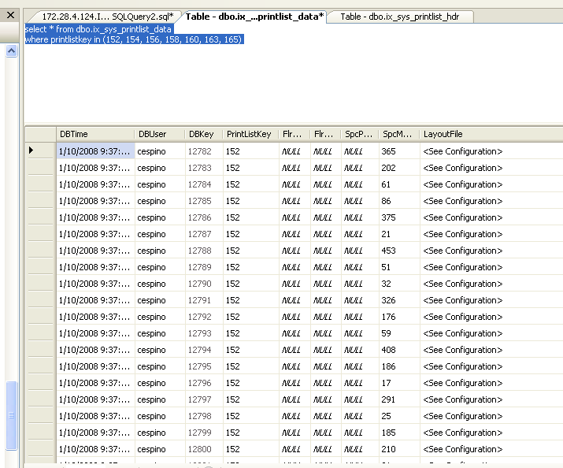
Query the dbkeys identified from dbo.ix_sys_printlist_hdr table in Printlistkey under dbo.ix_sys_printlist_data table

Slide 10
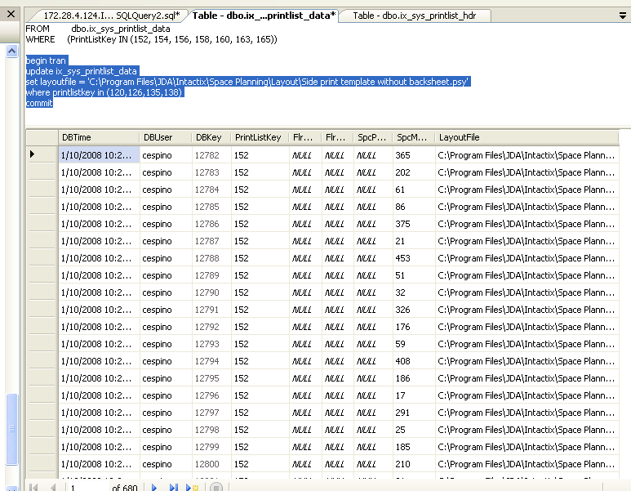
Replace the current LayoutFile with
C:\Program Files\JDA\Intactix\Space Planning\Layout\Side print template without backsheet.psy file

Slide 11
begin tran
update ix_sys_printlist_data
set layoutfile = 'C:\Program Files\JDA\Intactix\Space Planning\Layout\Side print template without backsheet.psy'
where printlistkey in (181,183,185)
commit
select * from ix_sys_printlist_data
where printlistkey = 185

Slide 12
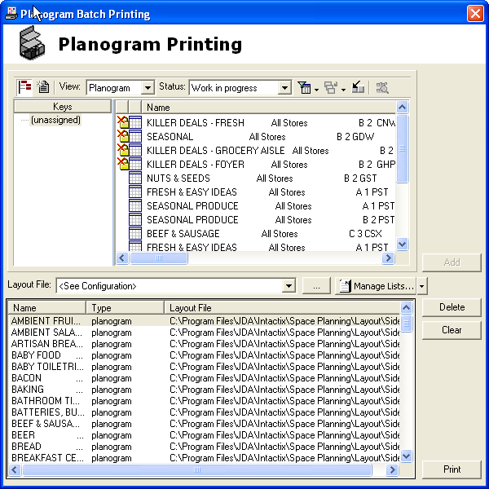
Go back to Data Manager > Stores Maintenance > Query the store you change the printlist info from
Select the Print icon (lower right hand side)
The Layout file you modified from the printlist key is now linked properly

